Slide 1


MAHENDRA COLLEGE OF ENGINEERING FINAL YEAR COMPUTER SCIENCE AND ENGINEERING ASSISTIVE OBJECT DETECTION AND GPS TRACKING SYSTEM FOR BLIND PEOPLE USING IOT AND PYTHON BATCH MEMBERS: GUIDE NAME 1.NANDHINI R(621521104088) Mr.M.JENOLIN REX M.E., 2.MOHANAPRIYA G(621521104083) AP/CSE 3.NAVEENA S(621521104091) 4.NITHYA A(621521104093)

Slide 2
ABSTRACT
Visually impaired individuals often face daily challenges while navigating unfamiliar or crowded environments. Relying solely on a walking stick or assistance from others can limit their independence and safety. To address this, we propose a smart assistive system that combines object detection, real-time tracking, and IoT technology.
A camera captures live video, which is processed using computer vision to recognize objects and moving hazards. Audio feedback is provided to guide the user safely. Meanwhile, a GPS module tracks the user’s location, and an IoT-enabled microcontroller sends this data to a cloud platform. Caregivers can monitor the user’s real-time location and obstacle alerts through a mobile app or web dashboard.
This solution allows blind individuals to move around more confidently while keeping their loved ones connected and informed at all times.

Slide 3
INTRODUCTION
Vision is vital for human mobility, but visually impaired individuals face significant challenges in navigating dynamic environments.
Traditional aids like white canes and guide dogs have limitations in obstacle detection and lack environmental awareness.
Emerging technologies such as embedded systems, computer vision, GPS, and IoT offer new possibilities for smarter assistive devices.
This project introduces a Smart Object Detection, Tracking, and GPS-Based IoT Assistive System for visually impaired users.
The system uses Arduino hardware, Python-based object recognition, vibration/audio feedback, and real-time GPS tracking.
IoT integration enables remote monitoring via cloud platforms, enhancing user safety, independence, and caregiver support.

Slide 4
LITERATURE REVIEW
Zoran Zivkovic introduced an Improved Adaptive Gaussian Mixture Model for dynamic background subtraction using recursive equations to update parameters and optimize component selection per pixel.
Athira Panicker developed a Smart Shopping Assistant for the blind using Raspberry Pi and voice output, effective only under specific text and background conditions.
Marut Tripathi et al. proposed a Navigation System for the Blind combining ultrasonic sensors and a USB camera to detect obstacles up to 300 cm, with feedback via earphones.
Dimitrios Dakopoulos and Nikolaos Bourbakis conducted a comparative study on Wearable Obstacle Avoidance ETAs, highlighting advancements and limitations in assistive navigation systems for the blind.
X. Chen et al. worked on Automatic Detection and Recognition of Signs from natural scenes, focusing on Chinese-to-English sign translation using camera input.
A. Ainsworth and William proposed a Text-to-Speech Conversion System for English, offering low-resource implementation but with memory limitations on some computers.

Slide 5
EXISTING SYSTEM AND DRAWBACKS
White canes and guide dogs are commonly used, but they lack the ability to detect distant or dynamic obstacles.
These aids provide no real-time information about the environment, making navigation difficult in complex areas
Emergency tracking and location monitoring features are absent, reducing user safety in unknown places.
Many systems do not support object recognition, limiting contextual awareness.
Auditory-only feedback in existing systems may not be sufficient or clear in noisy environments.
Some older systems are not connected to IoT, making remote monitoring by caregivers impossible.

Slide 6
PROPOSED SYSTEM
Implements camera-based obstacle detection using Python and OpenCV for real-time object recognition.
Integrates GPS tracking and IoT connectivity for continuous location monitoring and cloud-based updates.
Provides multimodal feedback via audio cues using a voice playback module.
Enables remote monitoring through cloud services, accessible via mobile or web interfaces for caregivers
Coordinates Arduino-based control with sensor inputs and network communication for real-time responsiveness.

Slide 7
ADVANTAGES OF THE PROPOSED SYSTEM
Enhances situational awareness through real-time sensory feedback.
Allows caregivers to monitor user status remotely, increasing peace of mind.
Cost-effective and scalable solution suitable for wide deployment.
Designed to improve the mobility of visually impaired individuals.
Boosts user independence, confidence, and safety through smart environmental interaction.

Slide 8






SYSTEM ARCHITECTURE
LCD
ARDUINO
WEB CAMERA
PC
UNO
VOICE IC
SPEAKER
GPS
IOT
ACCELERO
METER

Slide 9
SYSTEM SPECIFICATIONS
HARDWARE REQUIREMENT
ARDUINO UNO MICROCONTROLLER
LCD DISPLAY
ACCELEROMETER
VOICE IC
PC
SPEAKER (OR) HEADPHONE
IOT
GPS
SOFTWARE REQUIREMENT
ARDUINO IDE --- (CONTROLLER SIDE)
EMBEDDED C

Slide 10
HARDWARE COMPONENTS & THEIR FUNCTIONALITY
Arduino UNO – Acts as the central controller, interfacing with sensors and executing logic to manage obstacle detection and communication.
GPS Module – Continuously tracks the real-time geographical location of the user and feeds location data to the microcontroller.
ESP32 (IoT Module) – Enables wireless transmission of sensor and GPS data to cloud platforms like Thing Speak for remote monitoring.
Voice IC + Speaker/Headphones – Provides audio feedback to the user by converting detected messages into voice prompts or alerts.
Accelerometer – Detects movement or sudden falls, enhancing user safety by triggering alerts during abnormal motion.
Camera (Webcam or USB Camera) – Used a PC camera to perform real-time obstacle detection via Python and OpenCV.

Slide 11
SOFTWARE COMPONENTS & THEIR FUNCTIONALITY
Arduino IDE – Used for writing and uploading embedded C code to control Arduino hardware operations and sensor logic.
Python with OpenCV – Handles computer vision tasks such as object recognition and movement detection using real-time webcam input.
IoT Cloud Platform (e.g., Thing Speak, kIoT) – Receives and stores sensor/GPS data, enabling caregivers to track the user remotely.
Mobile/Web Dashboard – Displays live user location and alerts, allowing guardians or healthcare providers to monitor user status.
Voice Playback System – Controls audio output using Python or pre-recorded sound libraries to deliver situational awareness.
Serial Communication Interface – Facilitates data exchange between Arduino and Python system for synchronized real-time processing.

Slide 12
WORKING OF THE PROJECT
This data is processed by an Arduino UNO, which triggers alerts like vibrations or sound.
A web camera captures live video of the surroundings, and a Python-based OpenCV module analyzes this video to detect and recognize objects in real time.
Once objects or obstacles are identified, the system uses a Voice IC to convert this information into audio cues, which are played through a speaker or headphones to guide the user.
A GPS module tracks the user’s real-time location and sends the coordinates to the Arduino.
Finally, the ESP32 IoT module sends both GPS and obstacle data to a cloud platform (like ThingSpeak), allowing caregivers to monitor the user’s position and status remotely via a mobile or web dashboard.

Slide 13
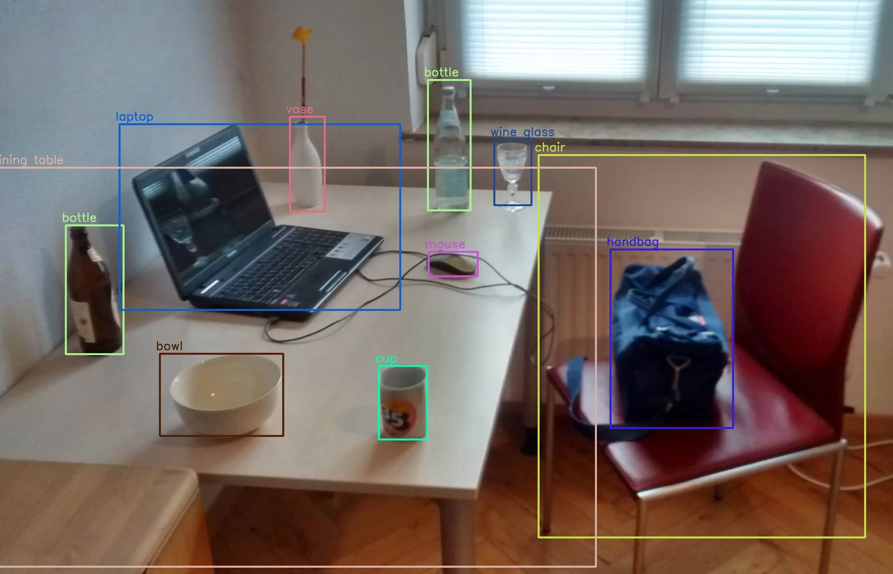
SAMPLE OUTPUTS

Slide 14
OBJECTS RECOGNIZED BY THE COMPUTER VISION MODEL
People & Animals - Person, Bird, Cat, Dog, Horse, Sheep, Cow, Elephant, Bear, Zebra, Giraffe
Vehicles - Bicycle, Car, Motorbike, Bus, Train, Truck, Boat, Aeroplane
Traffic & Street Items - Traffic Light, Fire Hydrant, Stop Sign, Parking Meter, Bench
Accessories & Sports
- Backpack, Umbrella, Handbag, Tie, Suitcase
- Frisbee, Skis, Snowboard, Sports Ball, Kite, Baseball Bat, Baseball Glove, Skateboard, Surfboard, Tennis Racket
Food & Drink
- Bottle, Wine Glass, Cup, Fork, Knife, Spoon, Bowl
- Banana, Apple, Sandwich, Orange, Broccoli, Carrot, Hot Dog, Pizza, Donut, Cake
Furniture & Home Items - Chair, Sofa, Potted Plant, Bed, Dining Table, Toilet, TV Monitor
Electronics - Laptop, Mouse, Remote, Keyboard, Cell Phone, Microwave, Oven, Toaster, Sink, Refrigerator
Miscellaneous - Book, Clock, Vase, Scissors, Teddy Bear, Hair Drier, Toothbrush

Slide 15
CONCLUSION
Developed a smart navigation system to assist blind individuals in both indoor and outdoor environments.
Aims to detect and solve obstacles in the path of visually impaired users.
Enhances personal safety through real-time monitoring and alerts.
Analyzes limitations of existing electronic assistive systems for the blind.
Utilizes IoT and GPS technologies for location tracking and smart navigation.
Includes an emergency triggering alarm system for quick assistance during critical situations.

Slide 16
FUTURE ENHANCEMENT
Integration with AI-based Voice Assistants Enhance user interaction by integrating with voice assistants like Alexa or Google Assistant to provide real-time verbal guidance and voice-controlled commands.
Advanced Object Recognition with Machine Learning Replace basic obstacle detection with AI-powered object classification (e.g., distinguishing between a vehicle, person, or step) to improve decision-making and situational awareness.
Vibration Feedback System Enhancement Customize vibration patterns based on object type, direction, and distance to provide more intuitive non-verbal cues.
Indoor Navigation using BLE Beacons Extend GPS limitations by incorporating Bluetooth beacons for accurate indoor positioning in shopping malls, hospitals, or large buildings.

Slide 17
REFERENCES
Millman J. and Halkias C.C., “Integrated Electronics”, McGraw Hill, 1972.
Roy Choudhury D. and Shail Jain, “Linear Integrated Circuit”, New Age International Publishers, New Delhi, 2000.
Mohammad Ali Mazidi, “The 8051 Microcontroller and Embedded System”.
Website References:
http://www.atmel.com
http://www.microchip.com
http://www.beyondlogic.org
http://www.aimglobal.org​
Wikipedia References (for technical terms and components): Includes topics such as LCDs, accelerometers, ultrasonic sensors, and audio electronics – sourced from en.wikipedia.org.

Slide 18
THANK YOU!!!

